Slide 1
CPS 235 Object Oriented Programming Paradigm
Lecturer Rabia Khan
Strings

Slide 2
What is a String?
A sequence of characters
C-string (or C-Style String): sequence of characters stored in adjacent memory locations and terminated by NULL character
The C-string
"Hi there!"
would be stored in memory as shown:
H
i
t
h
e
r
e
!
\0
CPS235:Strings

Slide 3
C-String
In C, a string can be a specially terminated char array or char pointer
A string is a sequence of character.
We have used null terminated <char> arrays (C-strings or C-style strings) to store and manipulate strings.
C++ provides a class called string.
We must include <string> in our program.
CPS235:Strings

Slide 4
C-String
If you write
char str[4] = {‘h’,’i’, ‘g’,’h’};
then str is an array of chars but not a string
In
char *p=“high”;
the system allocates memory of 5 characters long, stores “high” in the first 4, and ‘\0’ in the 5th
CPS235:Strings

Slide 5
Available Operations with Strings
Creating string objects.
Reading string objects from keyboard.
Displaying string objects to the screen.
Finding a substring from a string.
Modifying string objects.
Adding string objects.
Accessing characters in a string.
Obtaining the size of string.
And many more.
CPS235:Strings

Slide 6
Example
string s1, s3; // Using constructor with no arguments.
string s2(“xyz”); // Using one-argument constructor.
s1 = s2; // Assigning string objects
s3 = “abc” + s2; // Concatenating strings
cin >> s1; // Reading from keyboard (one word)
cout << s2; // Display the content of s2
getline(cin, s1) // Reading from keyboard a line of text
s3 += s1; // s3 = s3 + s1;
s3 += “abc”; // s3 = s3 + “abc”;
CPS235:Strings

Slide 7
Library Functions for working with C-Strings
strlen(str)
returns the length of a C-string
cout << strlen("hello");
Prints 5
CPS235:Strings

Slide 8
Library Functions for working with C-Strings
strcpy(dest,source)
Copies a string from a source address to a destination address
char name[15];
strcpy(name, “Pakistan");
cout << name; // prints Pakistan
CPS235:Strings

Slide 9
Library Functions for working with C-Strings
strcmp(str1,str2)
Compares strings stored at two addresses to determine their relative alphabetic order:
Returns a value:
  less than 0 if str1 is alphabetically less than str2
  equal to 0 if str1 equals str2
  greater than 0 if str1 is alphabetically greater than str2
CPS235:Strings

Slide 10
Library Functions for working with C-Strings
strcat(str1,str2)
Concatenates str2 to str1
char str1[] = “hi there,”;
char str2[] = “Tom”
cout<<strcat(str1,str2);
//prints hi there,Tom
CPS235:Strings

Slide 11
The C++ String Class
C++ has a <string> library
Include it in your programs when you wish to use strings: #include <string>
In this library, a class string is defined and implemented
It is very convenient and makes string processing easier than in C
The string class offers several advantages over C-style strings:
  large body of member functions
  overloaded operators to simplify expressions
CPS235:Strings

Slide 12
Declaration of strings
The following instructions are all equivalent. They declare x to be an object of type string, and assign the string “high school” to it:
  string x(“high school”);
  string x= “high school”;
  string x; x=“high school”;
CPS235:Strings

Slide 13
Overloaded string Operators
OPERATOR | MEANING
>> | reads whitespace-delimited strings into string object
<< | outputs string object to a stream
= | assigns string on right to string object on left
+= | appends string on right to end of contents of string on left
CPS235:Strings

Slide 14
Overloaded string Operators
OPERATOR | MEANING
+ | concatenates two strings
[] | references character in string using array notation
>, >=, <, <=, ==, != | relational operators for string comparison. Return true or false
CPS235:Strings

Slide 15
Operations on strings- (Input and Output)
int main()
{
string id, name, address;
cout<<"\nEnter your id";
cin>>id;
cout<<"\nEnter your full name";
getline(cin,name);
cout<<"\nEnter your address on separate lines(enter $ to terminate)";
getline(cin,address,'$');
cout<<"\nYour id is:"<<id;
cout<<"\nYour name is:"<<name;
cout<<"\nYour address is:"<<address;
getch();
return 0;
}
CPS235:Strings

Slide 16
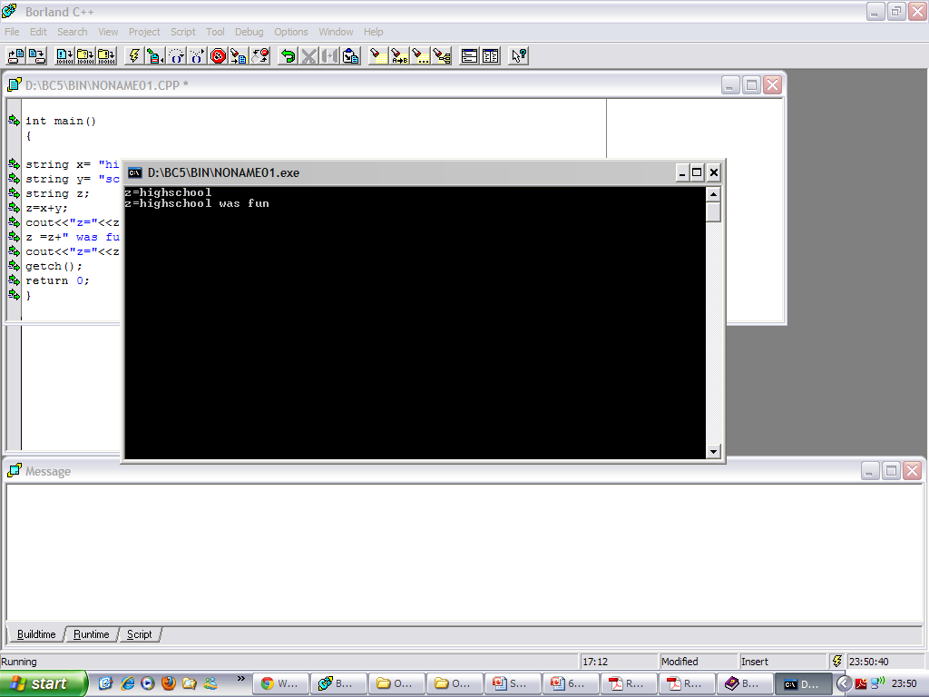
Operations on strings - (Concatenation)
Let x and y be two strings
To concatenate x and y, write: x+y
string x= “high”;
string y= “school”;
string z;
z=x+y;
cout<<“z=“<<z<<endl;
z =z+“ was fun”;
cout<<“z=“<<z<<endl;
CPS235:Strings

Slide 17
Concatenation of Mixed-Style Strings
In whwhere s is of type string,
  u can be
    A string object, or
    a C-style string (a char array or a char pointer),
    a C-style char
    or a double-quoted string,
    or a single-quoted character.
  Same with v and w.
  At least u or v or w must be a string object (the rest can be a char array etc)
s=u+v+w;
CPS235:Strings

Slide 18
Example of Mixed-Style Concat
string x= “high”;
char y[]= “school”;
char z[]= {‘w’,’a’,’s’,’\0’};
char *p = “good”;
string s= x+y+’ ‘+z+” very”+” “+p+’!’;
cout<<“s=“<<s<<endl;
cout<<“s=“+s<<endl;
Output:
s=highschool was very good!
s=highschool was very good!
CPS235:Strings

Slide 19
The concat-assign Operator +=
Assume x is a string object.
The statement
x += y;
is equivalent to
x = x+y;
where y can be a string object, a C-style string variable, a char variable, a double-quoted string, or a single-quoted char
CPS235:Strings

Slide 20
Comparison Operators for string Objects
We can compare two strings x and y using the following operators: ==, !=, <, <=, >, >=
The comparison is alphabetical
The outcome of each comparison is: true or false
The comparison works as long as at least x or y is a string object
  The other string can be a string object, a C-style string variable, or a double-quoted string
CPS235:Strings

Slide 21
Example of String Comparisons
string x= "high";
char y[]= "school";
char *p = "good";
if (x<y)
cout<<"x<y"<<endl;
if (x<“mystring")
cout<<"x<mystring"<<endl;
if ("low" != x)
cout<<"low != x"<<endl;
if (p>x)
cout<<"p>x"<<endl;
else
cout<<"p<=x"<<endl;
getch();
return 0;
}
Output:
x<y
x<mystring
low != x
p<=x
CPS235:Strings

Slide 22
The Index Operator []
If x is a string object, and you wish to obtain the value of the k-th character in the string, you write: x[k];
This feature makes string objects appear like arrays of chars.
string x= “high”;
char c=x[0]; // c is ‘h’
c=x[1]; // c is ‘i’
c=x[2]; // c is g
CPS235:Strings

Slide 23
Getting a string Object Length & Checking for Emptiness
To obtain the length of a string object x, call the method length() or size():
To check if x is empty (that is, has no characters in it):
int len=x.length( );
--or--
int len=x.size( );
bool x.empty();
CPS235:Strings

Slide 24
Obtaining Substrings of Strings
Logically, a substring of a string x is a subsequence of consecutive characters in x
For example, “rod” is a substring of “product”
If x is a string object, and we want the substring that begins at position pos and has len characters (where pos and len are of type int), write:
The default value of len is x.length( )
string y = x.substr(pos,len);
string y = x.substr(pos); //x[pos..end-1]
CPS235:Strings

Slide 25
Inserting a String Inside Another
Suppose x is a string object, and let y be another string to be inserted at position pos of the string of x
To insert y, do:
The argument y can be: a string object, a C-style string variable, or a double-quoted string
x.insert(pos,y);
CPS235:Strings

Slide 26
Replacing a Substring by Another
Suppose x is a string object, and suppose you want to replace the characters in the range [pos,pos +len) in x by a string y
To do so, write:
The argument y can be: a string object, a C-style string variable, or a double-quoted string
x.replace(pos,len,y);
CPS235:Strings

Slide 27
Deleting (Erasing) a Substring of a string Object
Suppose x is a string object, and suppose you want to delete/erase the characters in the range [pos,pos+len) in x.
To do so, write:
To erase the whole string of x, do:
x.erase(pos,len);
x.erase(pos); // erases x[pos..end-1]
x.clear( );
CPS235:Strings

Slide 28
Searching for (and Finding) Patterns in Strings
Suppose x is a string object, and suppose you want to search for a string y in x.
To do so, write:
This method returns the starting index of the leftmost occurrence of y in x, if any occurrence exits; otherwise, the method returns the length of x.
To search starting from a position pos, do
int startLoc = x.find(y);
int startLoc = x.find(y, pos);
CPS235:Strings

Slide 29
Searching for Patterns (Contd.)
To search for the rightmost occurrence of y in x, do
In all the versions of find and rfind, the argument y can be a string object, a C-style string variable, double-quoted string, a char variable, or a single-quoted char.
Searches a string in a backward direction for the first occurrence of a substring that matches a specified sequence of characters.
When pos is specified, the search only includes characters between the beginning of the string and position pos, ignoring any possible occurrences after pos.
startLoc = x.rfind(y); // or
startLoc = x.rfind(y, pos);
CPS235:Strings

Slide 30
Example
string x=“FROM:akhan@mcs.edu.pk”;
int colonPos=x.find(‘:’);
string prefix=x.substr(0,colonPos); //=FROM
string suffix = x. substr(colonPos+1);
cout<<“-This message is from ”<<suffix<<endl;
CPS235:Strings

Slide 31
Compulsory Reading
Robert Lafore, Chapter 7: Arrays and Strings
  Topics:
    C-Strings
    The Standard C++ String Class
CPS235:Strings

